Slide 1


Loan Prediction System
Project Title:
Meta Scifor Technologies
Presented BY : Patricia Stanley Intern ID : MST03-0053 Guided BY : Urooj Khan
Submission: 20th August, 2024

Slide 2

AGENDA
Introduction (Loan Prediction)
Project Overview
Dataset Information
Technology Stack
Methodology
SVM Model
Deployment and Visuals
Result and Discussion
Conclusion

Slide 3

What is Loan Prediction?
Loan approval is a critical decision-making process for financial institutions. The ability to accurately predict the likelihood of loan approval helps in reducing the risk of default and optimizing the loan approval process. This project develops a Loan Prediction System that automates the prediction process using machine learning algorithms. The system analyzes various factors such as applicant income, credit history, and property area to predict the approval status of a loan application. The goal is to enhance decision-making efficiency and reduce human bias.
Dataset link: https://www.kaggle.com/datasets/ninzaami/loan-predication

Slide 4




Project Overview:
The Loan Prediction System is a machine learning project designed to predict the approval status of loan applications based on various applicant data. This system leverages historical data, including factors like income, credit history, and employment status, to automate the decision-making process typically performed by financial institutions. The project employs multiple machine learning algorithms, with one including Support Vector Machines (SVM) to achieve high prediction accuracy. The final model is deployed using Streamlit, a Python-based framework that allows for real-time predictions and interactive data visualization through a web interface.

Slide 5
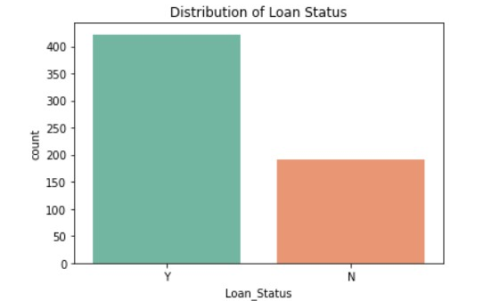
Dataset Information:
1) Key Features:
Loan_ID: Unique identifier for each loan application.
Gender: Applicant’s gender (Male/Female).
Married: Marital status (Yes/No).
Dependents: Number of dependents (0, 1, 2, 3+).
Education: Education level (Graduate/Not Graduate).
Self_Employed: Employment status (Yes/No).
ApplicantIncome: Income of the applicant.
CoapplicantIncome: Income of the co-applicant.
LoanAmount: Amount of the loan requested.
Loan_Amount_Term: Term of the loan in months.
Credit_History: Credit history status (1: Good, 0: Poor).
Property_Area: Area where the property is located (Urban, Semiurban, Rural).
Loan_Status: Target variable indicating loan approval (Y: Approved, N: Not Approved).
2) Data Source:
The dataset was sourced from Kaggle, which provides a rich collection of financial datasets, including this one focused on loan applications.
3) Visual Representation:
Distribution of Loan Status:
Use a bar chart to show the proportion of approved (Y) vs. not approved (N) loans.

Slide 6

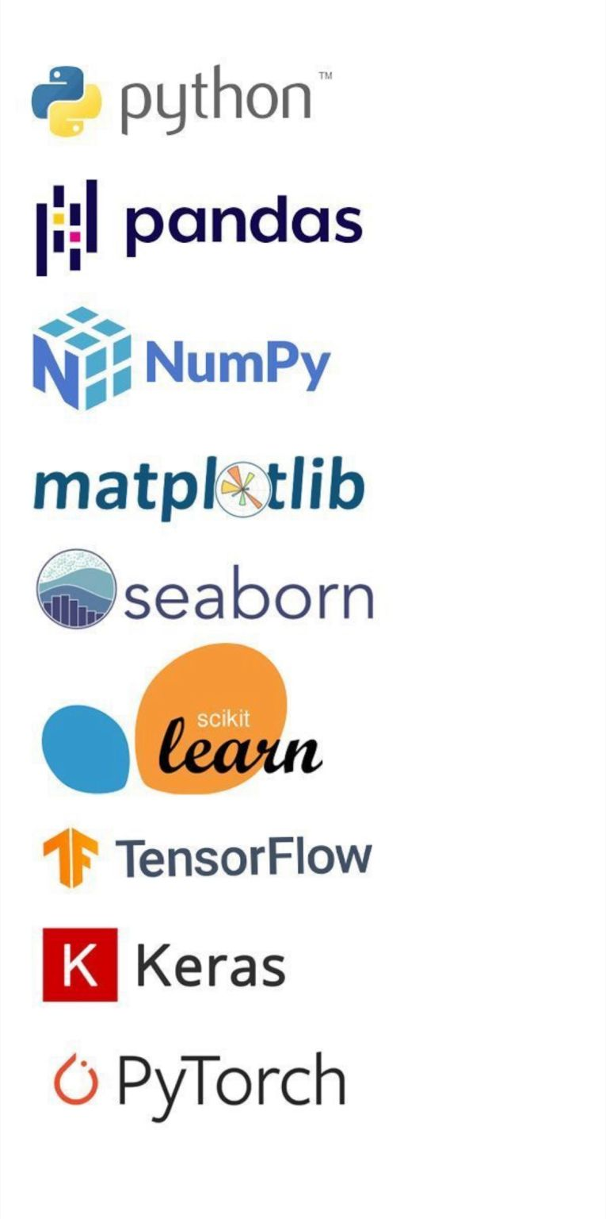
Technology Stack:
Objective: Outline the tools and technologies used in the Loan Prediction System project.
Programming Language:
Python: The primary language used for all aspects of the project, from data preprocessing to model development and deployment. Python’s versatility and extensive libraries make it ideal for machine learning projects.
Libraries:
Pandas & NumPy: Essential for data manipulation and analysis. Pandas is used for handling data frames, while NumPy provides support for numerical computations.
Scikit-learn: The core library for building and evaluating machine learning models, including SVM, Random Forest, and Logistic Regression.
Matplotlib & Seaborn: Used for data visualization and plotting graphs to gain insights into the dataset and model performance.
Deployment Framework:
Streamlit: A Python-based web framework used to deploy the model as an interactive web application. It enables real-time predictions and provides a user-friendly interface for end-users.

Slide 7
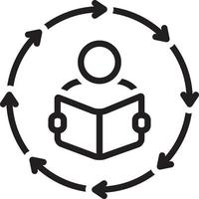
Methodology:
The methodology for the Loan Prediction System involves the following steps:
1. Data Preprocessing
Handling Missing Values: Missing data in columns such as LoanAmount and Credit_History is imputed using the median or mode.
Encoding Categorical Variables: Categorical variables like Gender, Education, and Property_Area are converted into numerical formats using one-hot encoding.
Feature Scaling: Features such as ApplicantIncome and LoanAmount are scaled using standardization to improve model performance.
2. Model Selection
Support Vector Machine (SVM): Selected for its ability to handle high-dimensional data and provide accurate classification results.
3. Model Training and Evaluation
The dataset is split into training and testing sets (80/20 split).
The models are trained on the training data.
The performance is evaluated using accuracy, precision, recall, and F1-score metrics.

Slide 8

SVM Model in the Loan Prediction System:
The Support Vector Machine (SVM) model plays a central role in the Loan Prediction System, offering a robust approach to binary classification. The SVM model was selected for its ability to handle high-dimensional data and its effectiveness in creating clear decision boundaries between classes—in this case, predicting whether a loan will be approved or not.
Why SVM?
SVM is particularly suited for this project because:
Margin Maximization: SVM focuses on finding the hyperplane that maximizes the margin between two classes, reducing the risk of misclassification.
Effectiveness in High-Dimensional Spaces: SVM works well even when the number of features exceeds the number of samples.
Flexibility with Kernels: SVM can handle non-linear classification problems using kernel functions, though a linear kernel was sufficient for this project.

Slide 9
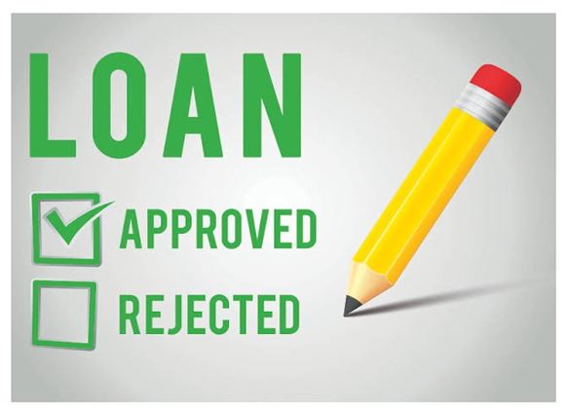
Model Deployment with Streamlit:
Deployment with Streamlit:
Streamlit Overview: Streamlit was chosen for deploying the Loan Prediction System due to its simplicity and ability to quickly convert Python scripts into interactive web applications.
Web App Creation: The Streamlit framework was used to build a user-friendly web app where users can input loan application details (such as income, loan amount, credit history) and receive instant predictions on loan approval status.
App Functionality:
User Inputs: The app allows users to enter relevant information like applicant income, loan amount, and credit history through interactive form fields.
Output Predictions: Upon submission, the app instantly displays the prediction (Approved/Not Approved) based on the trained machine learning model.
Real-Time Predictions: The web app leverages real-time prediction capabilities, providing immediate results as users input their data.

Slide 10
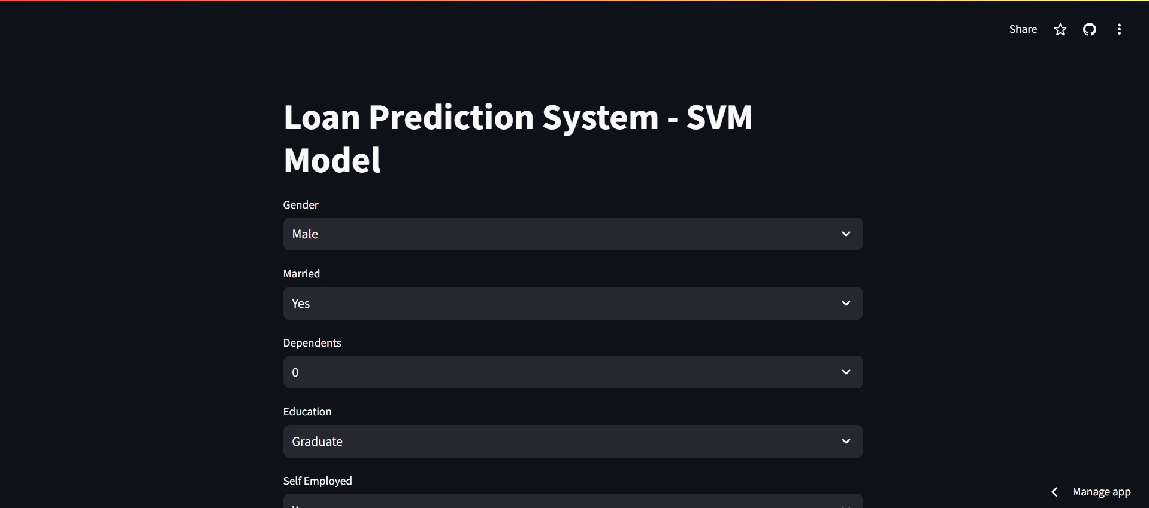
Visuals:
Screenshots: Include screenshots of the app, highlighting the input form and the resulting prediction output. This visual evidence demonstrates how the model functions in a practical, real-world scenario.
App Link : https://major-project-ugcs6t2u6bufyas59vh6ey.streamlit.app/

Slide 11



Result and Discussion:
SVM Model Performance:
The SVM model achieved an accuracy of 80% on the test data, indicating a reliable prediction capability for loan approvals.
The model also showed balanced precision, recall, and F1 scores, suggesting that it performs well across both classes(approved/denied loans).
Implications for Financial Institutions:
Automates the loan approval process, reducing manual workload and decision time.
Provides consistent and data-driven decisions, minimizing human bias and errors.
The model can easily scale to handle larger datasets or new data features, making it adaptable for various financial institutions.
Limitations and Mitigations:
The model’s accuracy could be further improved by including more features, such as credit scores or detailed employment history, which are currently not available in the dataset.
While SVM provides high accuracy, it can be less interpretable than simpler models. This was mitigated by focusing on a linear kernel, which offers more straightforward insights.

Slide 12

Conclusion:
The Loan Prediction System effectively automated the loan approval process, achieving an 80% accuracy with the SVM model. This demonstrates the project's ability to make reliable predictions and streamline decision-making in financial institutions.
By integrating machine learning, the system enhances the efficiency, consistency, and scalability of loan approvals. It reduces human errors and bias, leading to more accurate and fair decisions. This reflects the broader potential of machine learning to revolutionize financial services.

Slide 13

Future Improvements:
Adding More Features: Incorporate additional data points, such as credit scores or detailed employment history, to further improve prediction accuracy.
Enhancing Model Interpretability: Explore techniques to make the model’s decision-making process more transparent, helping stakeholders understand the factors influencing loan approval.
Expanding Scope: Extend the system to predict other financial outcomes, such as loan default risk or long-term financial stability of borrowers.

Slide 14

THANK YOU

